Slide 1


Slide 2
Group No. 11
1.Md. Tariqul Islam
ID: 2013-2-60-015
2. Sudipto Jahid
ID: 2014-1-60-073
3. Md. Sakibur Rahman
ID: 2014-1-60-032

Slide 3

We Have Visited
Sumona Gani Trade Center, Plot 2, Level 8 Panthapath, Dhaka 1215, Bangladesh
Dhaka, Bangladesh

Slide 4
Their Vision
Utilizing the global surge of IT spectacles, Their dream is to improve the socio-economic framework throughout the effective practice of business and customer service concurrently while paving the paths to success.

Slide 5
Their Mission
They focus on universal to IT issues through every possible mean, with utmost professionalism and passion. Their plan is to reach the peak of the sector in a few years from now with the support of the extensive knowledge of their team.

Slide 6
Their Goal
To become one of the leading tech solutions in the world and provide efficient, unique and top-notch service to all their clients, establishing a brand that people love, a brand that is always in close proximity to the users.

Slide 7
Their Belief
They assist individuals/inventors/entrepreneurs/fresh-thinkers in achieving their dream by being their trusted IT solution provider who ensure them an increased productivity and overall success by their very own rigorous accountability approach.

Slide 8

Tariqul

Slide 9
They Offer
Game Development
Web Design & Development
UI/UX Design
App Design & Development
Customized Software Development

Slide 10
Interview between HR & Us
Me: Do You Follow any kind of Software development Model??
HR: Yes ! We do.
Me: Which One ?
HR: Agile,Scrum.
Me: How do you collect your Requirements? Do you follow any Requirement Engineering ?
HR: Yes. We follow some particular process.

Slide 11
Interview between HR & Us
Me: We know that, there are some phase in Requirement Engineering, like Elicitation, Specification, Validation.
Which one do you follow??
HR: We follow Elicitation…sometimes We also follow Validation.
Me: Actually, I am enjoying our conversation.
HR: Me also. Smile.

Slide 12
Interview between HR & Us
ME: There are three ways in Elicitation phase..
1.Interview
2.Ethnography
3.Scenario
Which one do you follow ??
HR: That’s a very good question. I think you have taken a good preparation to interview me. Smile. Yes.. We Use Interview as well as Ethnography.

Slide 13
Interview between HR & Us
ME: How do collect your requirements?? Do you make direct interview with stake holder ??
HR: Yes ! We make direct interview with stake holders.
ME: When you make interview, do you make it individually or in a group ?
HR: Depends on situation. Sometimes individually, sometimes in group.
ME: Which types of interview do you perform?
HR: Both Open and closed.

Slide 14
Sakib

Slide 15
Interview between HR & Us
ME: Do you show prototype ?
HR: Yes! We Do.
ME: How do you filter and prioritise the collected requirements ??
HR: We have a team of specialist for filtering the requirements. Its little bit confidential, so I can’t tell you. Very Sorry.
ME: It's okay. Smile.

Slide 16
Interview between HR & Us
Me: Do you make any Documentation ?
HR: Yes. We make documentation. But We don’t use any specific method.
Just, Features | Fixes
ME: Do you review?
HR: Gameplay or technical review
Necessary Test List

Slide 17
Interview between HR & Us
ME: If it is needed to change the requirements, what do you do then ?
HR: DevOps | RERO
(DevOps is a software engineering culture and practice)

Slide 18
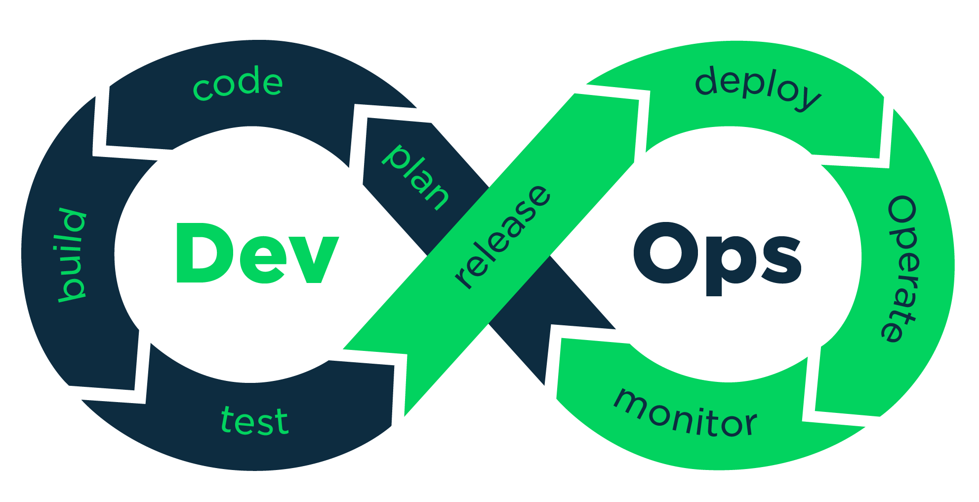

Slide 19


Slide 20


